Slide 1
Overview
Components of a Computer Systems
What is a Workload?
Components of a Workload
Workload Categories
Distributed Workloads - Multi-tier Architecture
Characteristics of Enterprise Workloads
Enterprise Workload Matrix
Typical Enterprise Problems

Slide 2
Workload
A unit of work i.e. a task performed by a
computer that uses computing resources

Slide 3
Workload Components
CPU time – processing cycles
Main memory - RAM
Secondary Storage – Disk or other mass storage device
Data movement i.e. I/O – Transfer data

Slide 4
Workload Categories
Compute Bound – uses mostly CPU time – processing cycles
Memory Bound – uses mostly Main memory - RAM
I/O Bound – uses mostly data transfer

Slide 5
Multi-Tier Architecture
Distributed
Presentation
Remote
Presentation
Distributed
Logic
Remote Data
Management
Distributed
Database
Data
Management
Data
Management
Data
Management
Data
Management
Data
Management
Application
Logic
Application
Logic
Application
Logic
Server
Data
Management
Presentation
Network
Application
Logic
Application
Logic
Application
Logic
Client
Presentation
Presentation
Presentation
Presentation
Presentation

Slide 6
Enterprise Problem Characteristics
Scale
Volatility
Complexity
High reliability
High availability
Consequential
High risk
High security

Slide 7
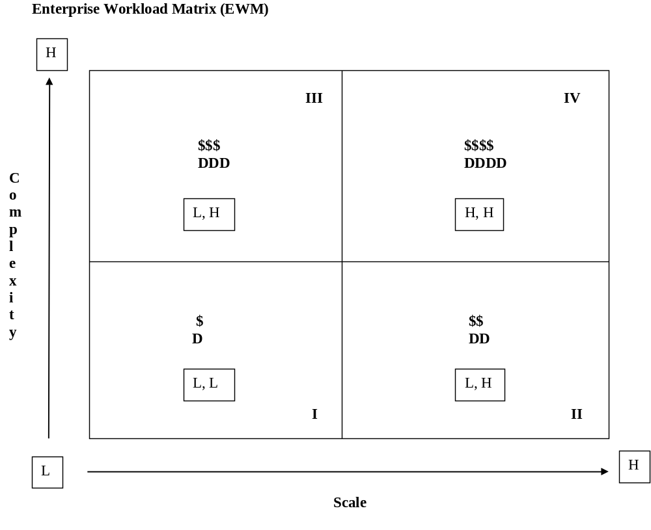
Enterprise Workload Matrix

Slide 8
Typical Enterprise Problems
Visa
89.7 billion Transactions
$4.4 trillion
2 z/13’s
Google
1.2 trillion searches
$59.1 billion
1000 computers for avg. search

Slide 9
Next Time
Data in the Computer

